Slide 2
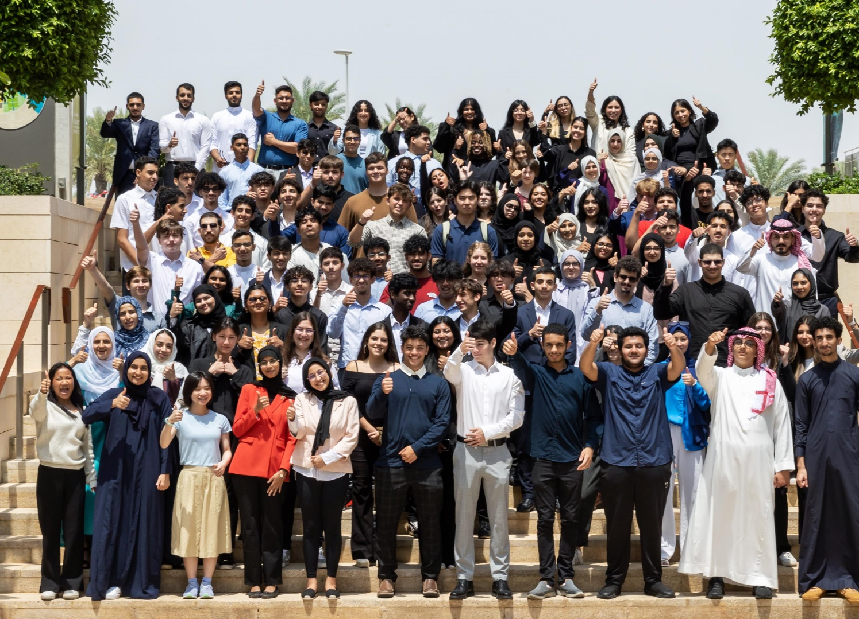
2024 Summer Program

Slide 3
2024 Summer Program
WISER was established in 2016 as a four-week Summer program designed for TKS students in Grades 10-12 and undergraduate students visiting home during the summer break. In 2016 there were 37 interns. The program has grown year-on-year, and in 2023, we welcomed 116 interns
Summer Program Objectives
Academic Enhancement: strengthening knowledge and skills
Career Exploration: providing opportunities to explore career paths and gain insights into the research and professional world
Personal Development: promoting personal growth, communication skills, leadership, time management, and critical thinking
Summer Program Structure
A four-week full-time internship
Engagement activities: including guest speakers, team projects, social events… and more

Slide 4
2024 Summer Program
WISER 2024 Summer Program: Sunday, July 21 to Thursday, August 15
Expected Commitment: School Students – 6 hours daily; University students – 8 hours daily
Documentation: Maintain a reflection/learning journal
Assessment/Evaluation: performance-based stipend
Competition: internship placements are limited = a competitive selection process

Slide 5
2024 Summer Program
January
KAUST departments and research areas submit their internship proposals
February
Information session for mentors
First Skills Lab at TKS (Resumé writing)
March
Application window opens
Second Skills Lab at TKS (Interview Skills)
April/May/June
Interviews and selection
Offer letters
July
Program starts
Orientation/first mandatory session
August
Second mandatory session
Expo and Closing Ceremony

